Slide 1
CITY OF SCRANTON
ARPA NOTICE OF FUNDING AVAILABILITY FOR:
LOCAL ART ORGANIZATIONS – RECOVERY GRANTS
March 7th,2024
PRESENTED BY:
Notes:
Slide 1: Dave
Welcome

Slide 2
agenda
Purpose
ARPA Overview
NOFA Summary and Structure
Subrecipient vs Beneficiary
How to Apply
Timeline
Questions
Notes:
Slide 2: Dave

Slide 3
purpose
Provide an overview of the City’s Local Art Organization Recovery Program
Define eligible beneficiaries (Local Art Organizations) and eligible uses of funding, if awarded
Demonstrate how applicants can apply
Notes:
Slide 3: Dave

Slide 4
American rescue plan overview
EXAMPLES OF ELIGIBLE USES FOR ARPA FUNDS
$1.9 Trillion Economic Stimulus Bill
No Longer Eligible
$365 Billion to State-Local Governments
$68.75 Million to the City of Scranton
Notes:
Slide 5: Dave

Slide 5
FUNDING OPPORTUNITIES
Public Health/Education – 2.5M**
COVID19 Vaccine Program
Behavioral Health, Violence Prevention
Wellness Programming
DDAP Drug Overdose Prevention
Housing – 1.7M**
Home Buyer Program
Housing – Solar
Economic Recovery – 6.3M**
NEPA Thrives
SACF Small Business Grants
Living Alley Outdoor Dining
Small Business Façade Grants
NEW: Disaster Relief – 2.5M**
NEW: Individual Relief Assistance
NEW: Disaster Repair/Mitigation
Affordable Childcare
Educational Catchup K-12
NEW: Pre-K Education Programs*
NEW: Childcare Individual Reimbursements*
NEW: Childcare Service Provider Wage Boost*
Housing – Rehab and Weatherization
Housing – Lead abatement
Small Business Start Up and Expansion Funding
SACF Non-Profit Grants
NEW: Small Business Technology Grants*
NEW: Local Art Organization Grants*
*Funds were re-purposed from another grant program within the same category
**Subject to funding availability

Slide 6
Funding opportunities
CLOSED PROGRAMS
OPEN SUBRECIPIENT PROGRAMS
OPEN BENEFICIARY PROGRAMS
CLOSED
CLOSED
CHILDCARE SERVICE PROVIDER
WAGE BOOST GRANTS Assistance for childcare providers
LOCAL ART ORGANIZATION
RECOVERY GRANTS Assist local arts community in recovery
SMALL BUSINESS GRANTS Startup and Expansion
CLOSED
CLOSED
SMALL BUSINESS GRANTS Wage boost and recovery
DISASTER RECOVERY INDIVIDUAL ASSISTANCE GRANTS Assist Individuals/Residents impacted by the recent Disaster
Small Business Façade Grants
Notes:
Update graphics***

Slide 7
Beneficiary V. subrecipient
RECIPIENT
Subrecipient
Determines who is eligible to receive Federal assistance
Measures performance based on meeting objectives of the Federal program
Is responsible for programmatic decision making
Is responsible for ensuring Federal requirements outlined in the award are followed
Uses the Federal funds to carry out a program as opposed to providing goods/services
SUBRECIPIENT
Local Arts
Recovery Grants
Beneficiary
Is an individual or organization receiving the funds as the end user or entity directly benefitting from the financial assistance
Does not determine eligibility or compliance
BENEFICIARIES
Notes:
* On availability of funding

Slide 8
Beneficiary eligibility
Beneficiary Eligibility
Local Arts organizations that operate within the City of Scranton and under the following NAICS codes:
NAICS Code: 711510 - Independent Artists, Writers, and Performers
NAICS Code: 711110 - Theater Companies and Dinner Theaters
NAICS Code: 711130 - Musical Groups and Artists
NAICS Code: 711120 - Dance Companies
Must have been operational prior to the start of the pandemic (March 2020) and provide evidence to that effect.
Must provide evidence of number of employees prior to the start of the Pandemic.
Must be in good standing and registered with the City Single Tax Office as well as current with local taxes and trash fees.
During the period beginning on March 1, 2020, and ending at the time the application is submitted, the applicant has not received alternate Federal, State, or local grant funding to cover these same costs and/or impacts.
*Additional requirements are outlined in the guidance document
LOCAL ART ORGANIZATION
RECOVERY GRANTS Assist local arts community in recovery
Notes:
* On availability of funding

Slide 9
Beneficiary
Examples of Eligible Uses
Costs to retain employees and/or hire back to pre-pandemic levels
Mitigate financial hardships including, but not limited to, decreased revenue, financial insecurity, increased costs caused directly by the pandemic, as well as challenges covering other costs including mortgage payments, rent, utilities, and other operational costs.
Costs to cover COVID-19 mitigation efforts including social distancing, cleaning, disinfecting, separation barriers, and other health and safety investments or upgrades.
Funding for technical assistance, counseling, or other services to support business planning.
LOCAL ART ORGANIZATION
RECOVERY GRANTS Assist local arts community in recovery
Notes:
* On availability of funding

Slide 10
HOW TO APPLY
How to Apply
Our grant application process is streamlined through our online grant management portal. All grant requests are handled through the online portal.
URL: Neighborly Software
Notes:
* On availability of funding

Slide 11
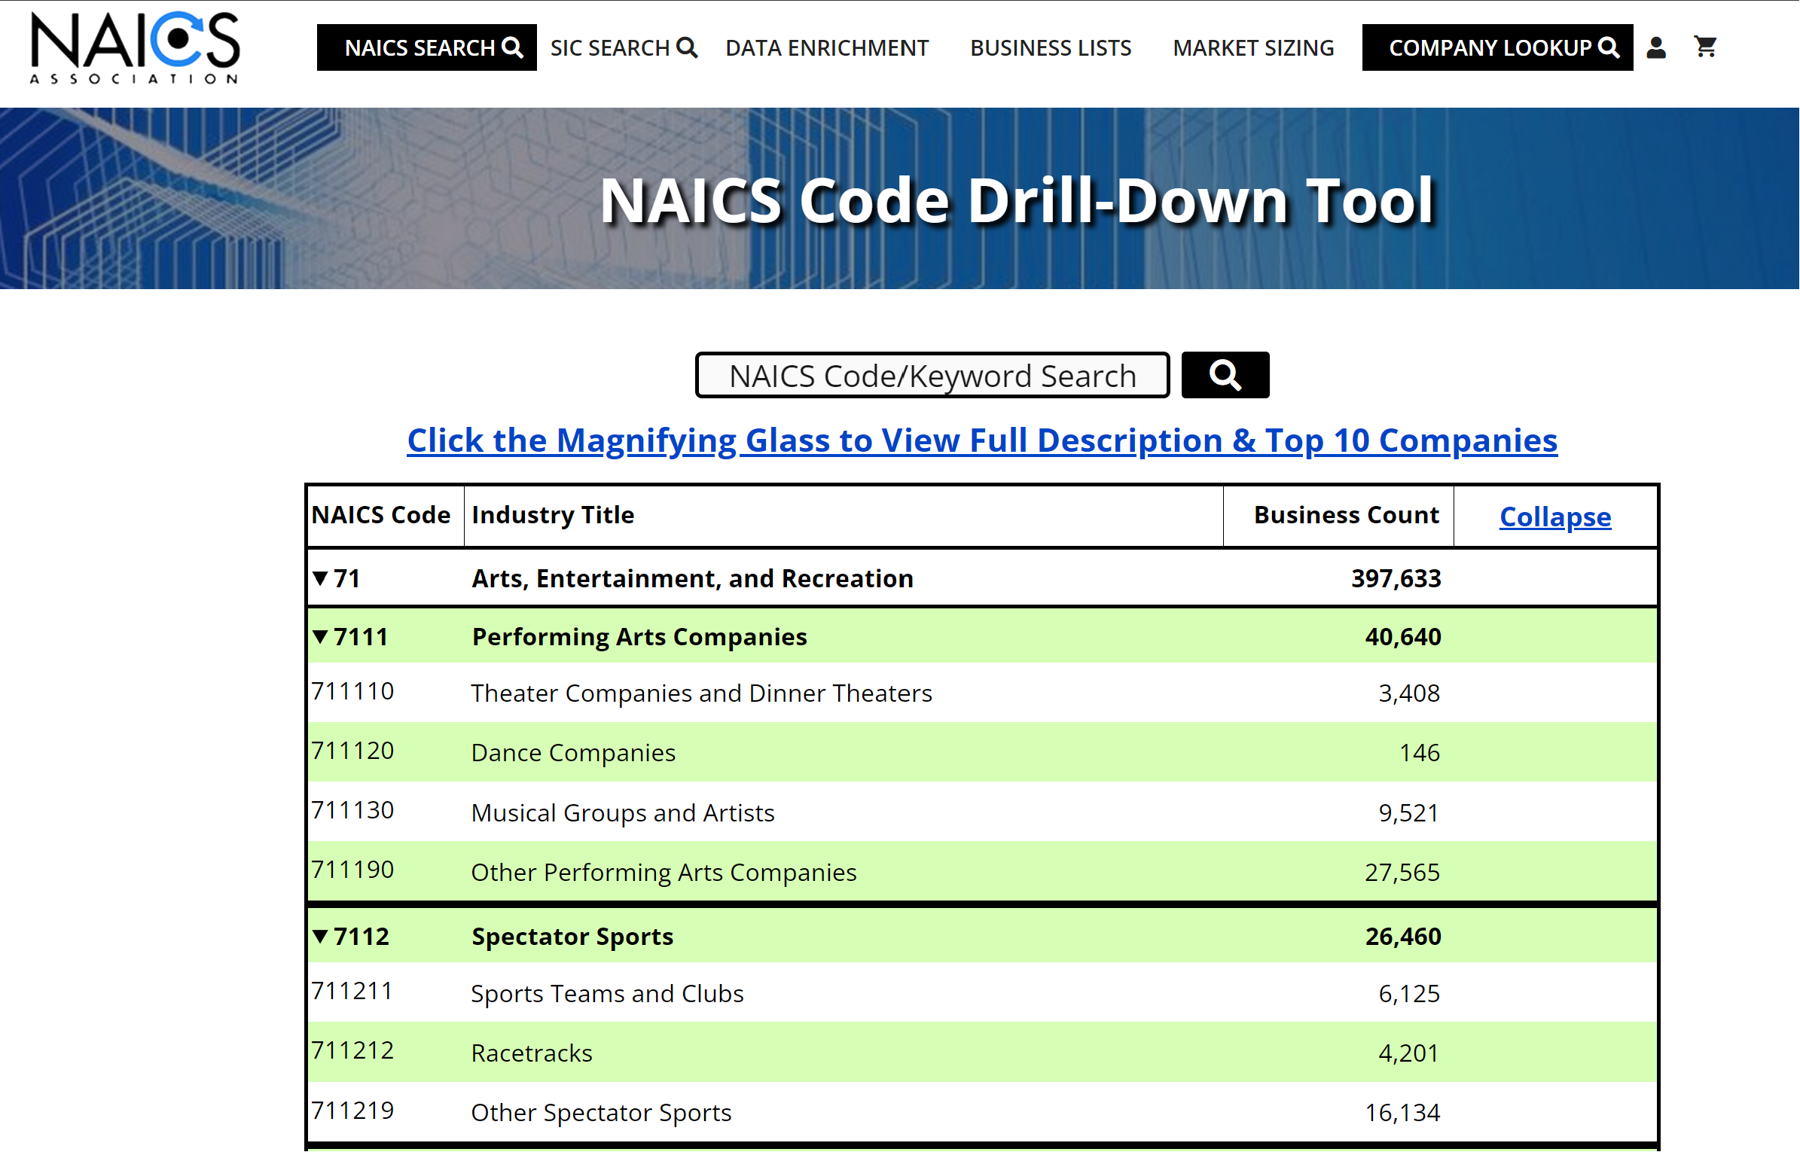
NAICS CODES REVIEW
How to confirm NAICs Code
Six Digit NAICS Codes: 71 Arts, Entertainment, and Recreation | NAICS Association
NAICS Code: 711510 - Independent Artists, Writers, and Performers
NAICS Code: 711110 - Theater Companies and Dinner Theaters
NAICS Code: 711130 - Musical Groups and Artists
NAICS Code: 711120 - Dance Companies
Notes:
* On availability of funding

Slide 12
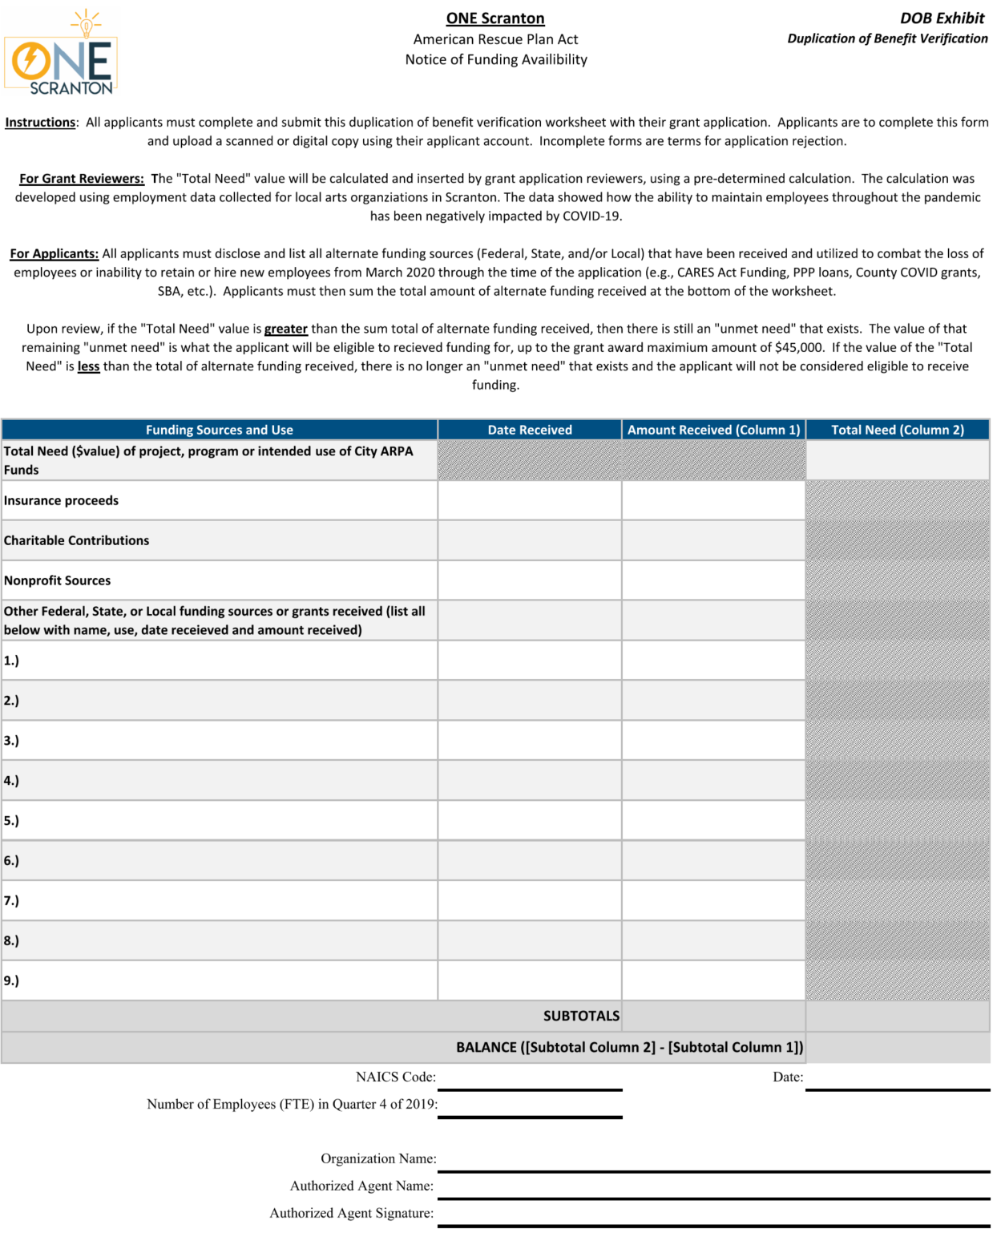
HOW TO APPLY - NEIGHBORLY
Beneficiary DOB Exhibit
If an applicant has received alternate grant funding from other sources that are intended to be used for this same purpose, the applicant will need to disclose those sources and amounts on Exhibit 2 so a duplication of benefit analysis can be conducted.
Notes:
* On availability of funding

Slide 13
Scoring/prioritization
Review panel members may consider the following factors in their evaluation:
Organization is an eligible entity.
Quality of the organization’s application and documentation evidence submitted.
Organization’s location within the city. Organizations located in QCT areas may be given higher priority for funding.
Impact of COVID-19 is clear and demonstrated in the applicant’s application narrative.
If the applicant has received alternate funding from other federal or state sources for the same request.
Other factors as deemed appropriate by the panel members.
Notes:
* On availability of funding

Slide 14
TIMELINE
Grant Program Timeline
February 29th, 2024 | Release of application
March 7th, 2024 | Information Session and Assistance
April 12th, 2024 | Deadline for application submissions
April 12th, 2024 – May 17th , 2024 | Application review period
May 31st, 2024 | Award determinations

